Slide 1
Zynq Architecture -- Extend Embedded System into PL with Vivado
Zynq
Vivado 2015.2 Version

Slide 2
Outline
PS-PL Interface
PL Clocking Sources
Zynq Resets
Process of adding IP to PL

Slide 3
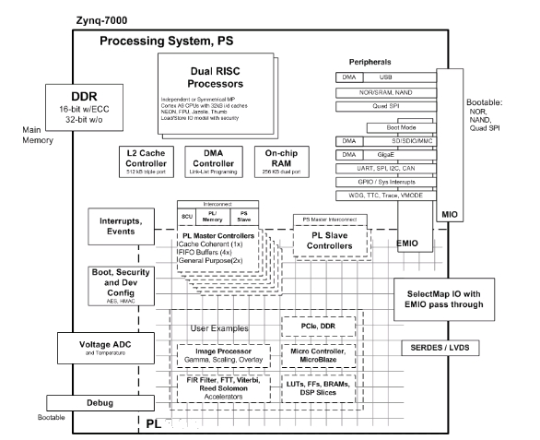
PS Components
The Zynq AP SoC processing system consists of the following blocks
Application processing unit (APU)
I/O peripherals (IOP)
Multiplexed I/O (MIO), extended multiplexed I/O (EMIO)
Memory interfaces
PS interconnect
DMA
Timers
Public and private
General interrupt controller (GIC)
On-chip memory (OCM): ROM and RAM
Debug controller: CoreSight
Notes:
APU vs. CPU(Central Processing Unit)

Slide 4
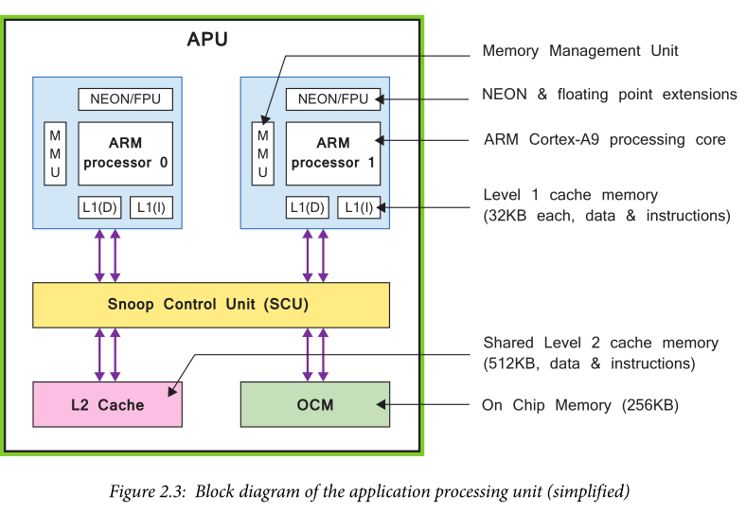
Notes:
The Snoop Control Unit (SCU) connects one to two Cortex-A9 cores to the memory system through the AXI interfaces.

Slide 5
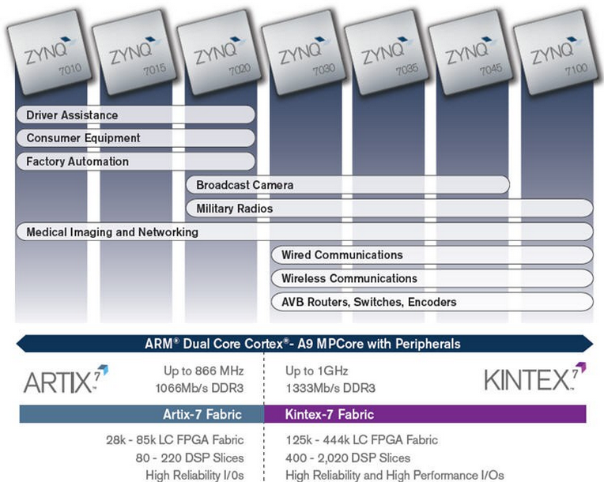
The PS and the PL
The Zynq-7000 AP SoC architecture consists of two major sections
PS: Processing system
Dual ARM Cortex-A9 processor based
Multiple peripherals
Hard silicon core
PL: Programmable logic
Uses the same 7 series programmable logic, based on the following two FPGA fabrics
Artix™-based devices: Z-7010, Z-7015 and Z-7020 (high-range I/O banks only)
Kintex™-based devices: Z-7030, Z-7035, Z-7045, and Z-7100 (mix of high-range and high-performance I/O banks)

Slide 6
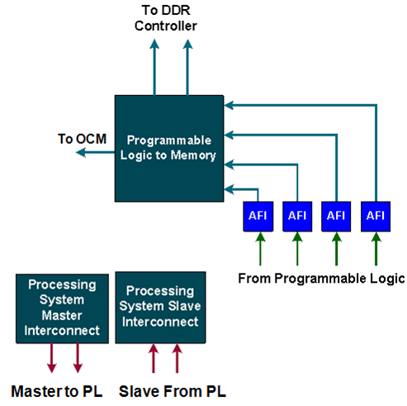
PS-PL Interfaces
AXI general-purpose ports (GP0-GP1)
Two masters from PS to PL
Two slaves from PL to PS
32-bit data width
Conversation and sync to processing system clock domain
Clock and resets
Four PS clock outputs to the PL with enable control
Four PS reset outputs to the PL

Slide 7
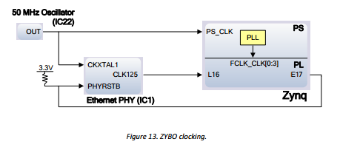
PL Clocking Sources
PS clocks
PS clock source from external package pin
PS has three PLLs (Phase-Lock-Loop) for clock generation
PS has four clock ports to PL
The PL has 7 series clocking resources
PL has a different clock source domain compared to the PS
The clock to PL can be sourced from external clock capable pins
Can use one of the four PS clocks as source
Synchronizing the clock between PL and PS is taken care of by the architecture of the PS
PL cannot supply clock source to PS
Notes:
The ZYBO provides a 50 MHz clock to the Zynq PS_CLK input, which is used to generate the clocks for each of the PS subsystems. The 50 MHz input allows the processor to operate at a maximum frequency of 650 MHz and the DDR3 memory controller to operate at a maximum of 525 MHz (1050 Mbps).
The ZYBO Base System Design configures the PS to work properly with this input clock, and should be used as a reference when creating custom designs.
The PS has a dedicated PLL capable of generating up to four reference clocks, each with settable frequencies, that can be used to clock custom logic implemented in the PL. Additionally, The ZYBO provides an external 125 MHz reference clock directly to pin L16 of the PL. The external reference clock allows the PL to be used completely in dependently of the PS, which can be useful for simple applications that do not require the processor.

Slide 8
Zynq Resets
Internal resets
Power-on reset (POR)
Watchdog resets from the three watchdog timers
Secure violation reset
PS resets
External reset: PS_SRST_B
Warm reset: SRSTB
PL resets
Four reset outputs from PS to PL
FCLK_RESET[3:0]

Slide 9
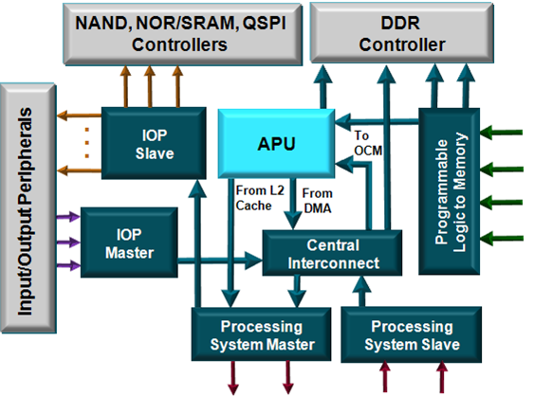
Processing System Interconnect (1)
Programmable logic to memory
Two ports to DDR
One port to OCM SRAM
Central interconnect
Enables other interconnects to communicate
Peripheral master
USB, GigE, SDIO connects to DDR and PL via the central interconnect
Peripheral slave
CPU, DMA, and PL access to IOP peripherals

Slide 10
Processing System Interconnect (2)
Processing system master
Two ports from the processing system to programmable logic
Connects the CPU block to common peripherals through the central interconnect
Processing system slave
Two ports from programmable logic to the processing system

Slide 11
Communicating with PL
Processing system master
Two ports from the processing system to programmable logic
Connects the CPU block to common peripherals through the central interconnect
Processing system slave
Two ports from programmable logic to the processing system
Slave PL peripherals address range
4000_0000 and 7FFF_FFFF (connected to GP0) and
8000_0000 and BFFF_FFFF (connected to GP1)
GP0 GP1

Slide 12
Process of Adding IP to PL
PS functionality can be extended by instantiating peripherals in PL
Adding IP in PL involves
Enabling interface(s) in PS
Selecting IP from the IP Catalog and configuring IP for desired functionality
Connecting the (PL) IP to the PS using IP Integrator
Assigning address
Connecting IP ports to ports of other peripherals and/or to external pins
HDL Wrapper is needed for IP Integrator Block
Bitstream must be generated when PL has any IP
The FPGA must be programmed with the generated hardware bitstream before an application can be run

Slide 13
ARM Cortex-A9 based Embedded System Design Lab2: Adding IPs in PL
ARM
Cortex-A9
PL
Memory
DDR3
Memory
Controller
RS232
UART
AXI
Interconnect
Block
M_AXI_GP0
AXI4-Lite
GPIO
Push-Buttons
PS
AXI4-Lite
GPIO
DIP Switches

Slide 14
Procedure
Open the project in Vivado
Enable GP0 in PS
Add and configure GPIO peripherals in the system in the IP Integrator
Add external ports
Generate the bitstream and export to SDK
Create a TestApp application in SDK
Verify the functionality in hardware

Slide 15
Three Major Steps
The GP Master interface of the PS was enabled. GPIO peripherals were added from the IP catalog and connected to the Processing System through the 32b Master GP interface.
The peripherals were configured and external FPGA connections were established. Pin location constraints were made using IP Integrator Automation, and also manually, to connect the peripherals to push buttons and DIP switches.
A TestApp application project was created and the functionality was verified after downloading the bitstream and executing the program.

Slide 16
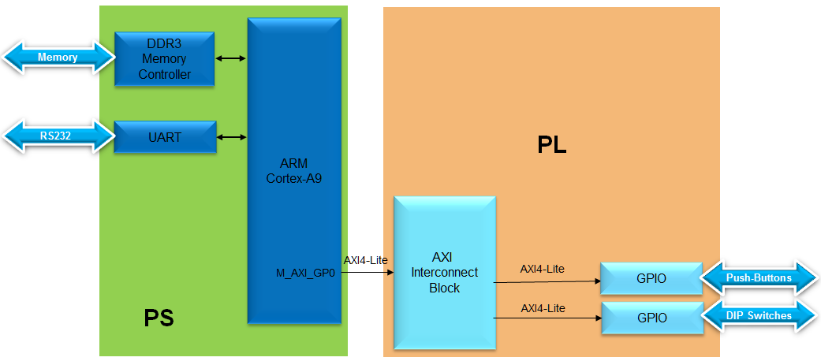
Design Example with Switches Connected

Slide 17
IP Peripherals Included as Source (Free)
External peripheral controller Memory and memory controller
High-speed and low-speed communication peripherals
AXI 10/100 Ethernet MAC controller
Hard-core tri-mode Ethernet MAC
AXI IIC
AXI SPI
AXI UART
Other cores
System monitor
Xilinx Analog-to-Digital Converter (XADC)
Clock generator, System reset module
interrupt controller
Traffic Generator, Performance monitor
Bus and bridge controllers
AXI to AXI connector
Local Memory Bus (LMB)
AXI Chip to Chip
AHB-Lite to AXI
AXI4-Lite to APB
AXI4 to AHB-Lite
Debug cores
Integrated Logic Analyzer
DMA and Timers
Watchdog, fixed interval
Inter-processor communication

Slide 18
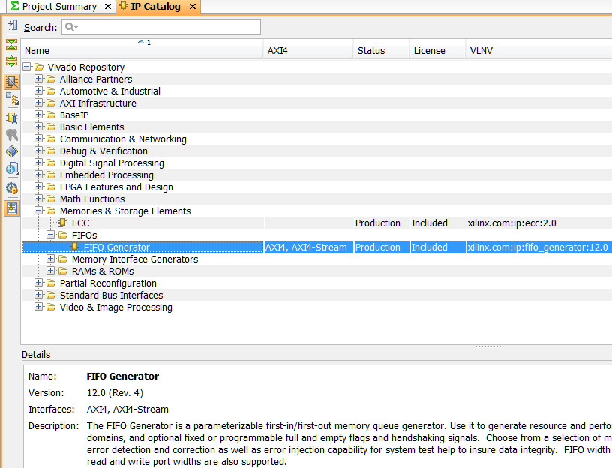
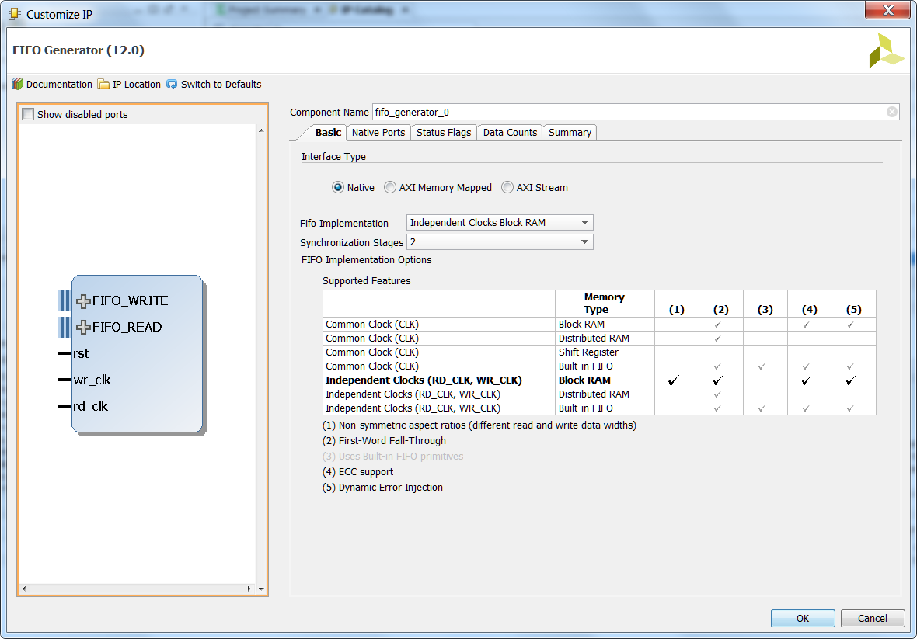
Vivado IP Catalog
Integrated IP Support
Instant access to IP customization
Vivado IP GUI look and feel
Support for Vivado synthesis and implementation
Selectable IP output products
Full Tcl support
Notes:
Vivado has a unified IP catalog – all IP available in one place. The catalog can be extended through use of additional repositories. IP can be selected in the catalog and customization GUIs launched. IP is then added directly to a Vivado project, or in the case of IP Integrator, added to the diagram. The user can select simulation or implementation files. IP can be accessed and customized entirely from the Tcl console as well.

Slide 19
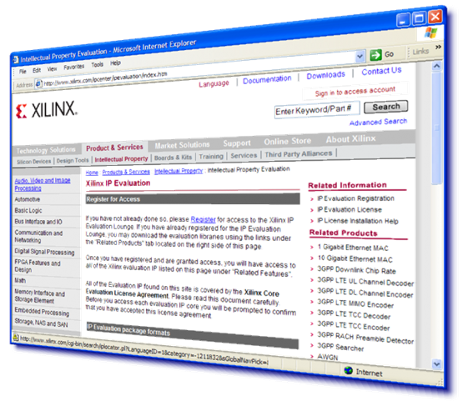
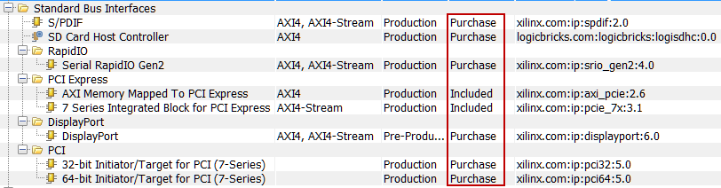
IP Cores Included as Evaluation
AXI CAN controller
AXI USB2 device
Video IP
Telecoms/ Wireless IP
Xilinx developed, delivered, and supported
Evaluation IP installs with a 90-day evaluation license

Slide 20

GP Ports
By default, GP Slave and Master ports are disabled
Enable GP Master and/or Slave ports depending on whether a slave or a master peripheral is going to be added in PL
axi_interconnect block is required to connect IP to a port with different protocols
Automatically convert Protocols
Can be automatically added when using Block Automation in IPI

Slide 21
Configuring GP Ports
Click on the menu or green GP Blocks to configure

Slide 22
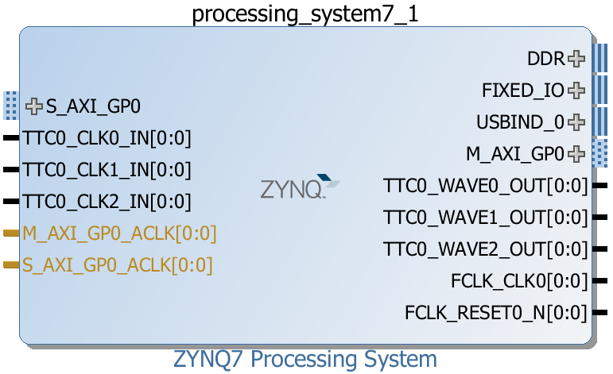

Add IP in the PL
Configure GP ports from PS Customization GUI
PS-PL Configuration
E.g. Enable M_AXI_GP0/1 or S_AXI_GP0/1
Ports will then be available on Zynq Block Diagram
Connect the added IP to the appropriate port
Assign address to the added IP, if unmapped
Configure the IP, if necessary
Make external connections, if needed
Add external ports/interfaces if the added IP is interacting with external devices

Slide 23
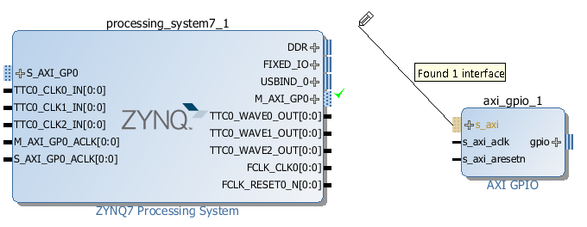
Connecting IP
Add IP from the IP Catalog
Click and drag to find connections
Valid connections Highlighted
Designer Assistance, Connection automation
If Board Support available, IP can be connected to external pins
Or manually create and connect (external) ports

Slide 24
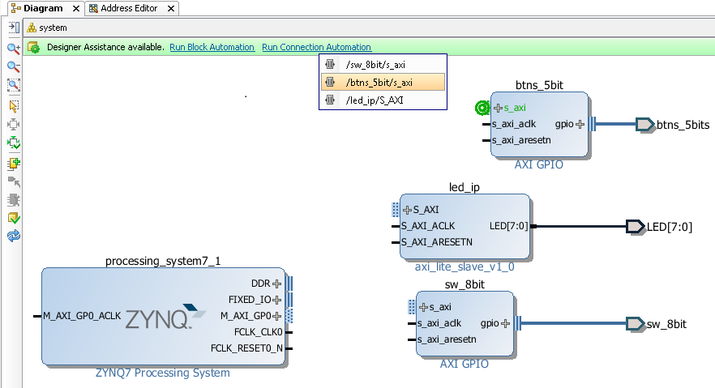
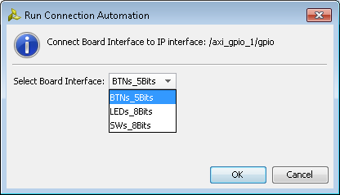
Designer assistance; Block Automation, Connection Automation
Block, Connection
Can automatically connect IP blocks
Automatically insert required blocks
E.g. Add BRAM; Automation will insert and connect BRAM controller and Reset logic
If Board Support is available, IP can automatically be connected to top level ports

Slide 25
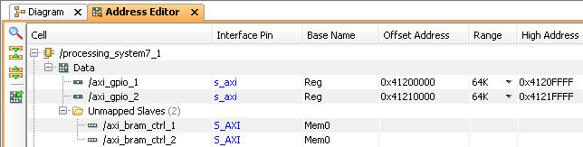
Assign Addresses
Peripherals in the Zynq™ AP SoC PS have fixed addresses and do not appear in the address map when an IP is added to the system
For PS peripherals Click on the Auto Assign Addresses button
The address will be generated and show the generated addresses of the added IP
The fixed addresses of the configured peripherals of the PS

Slide 26
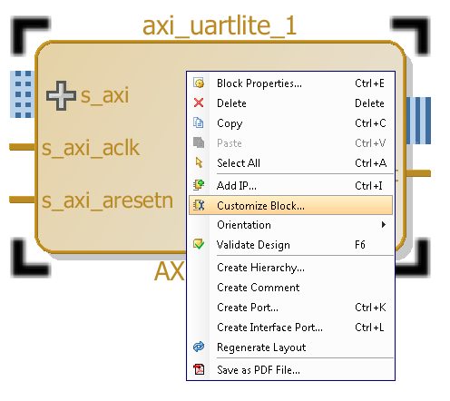
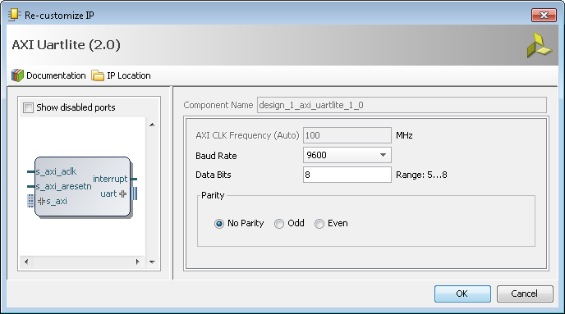
Parameterize IP Instances
Double-click or right click the instance and select Customize Block to open the configurable parameters dialog box (refer to the datasheet if needed)
Default values are shown
Customize the parameters that you want

Slide 27
Simulation, Synthesis, and Implementation
Simulation is verifying the functionality of the design . There are two kinds of simulation: 1- behavioral (functional) simulation which is done pre-fit (before synthesis) 2- Timing simulation which is done post-fit (after synthesis) to ensure that it has achieved the required timing.
Synthesis is to implement the design by translating the design into a next level of abstraction: from RTL level to gate level.
Implementation is to translate netlist into the placed and routed FPGA design.
From SW designers' view, Simulation process is something like the debugging process, while the Synthesis and implementation process is something like the compile-link-make process. The Synthesis process is the key point of EDA technology, which makes the Automatic process possible.
Notes:
In digital circuit design, register-transfer level (RTL) is a design abstraction which models a synchronous digital circuit in terms of the flow of digital signals (data) between hardware registers, and the logical operations performed on those signals. It is usually written in HDL.

Slide 28
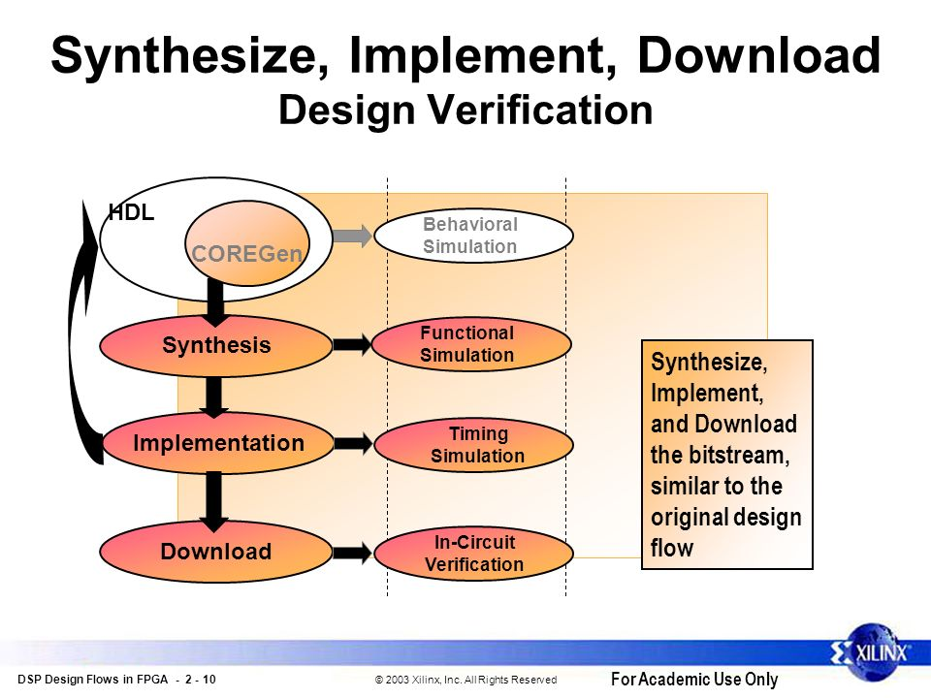

Slide 29
Bitstream Generation
After defining the system hardware, the next step is to create hardware netlists if the system hardware has logic in PL
An HDL wrapper for the block diagram must be generated
Additional logic can be added to the HDL, or the Processor system can be used as a sub block in a HDL design
The design and block diagram must be open before synthesise and implementation can be carried out
If the system contains hardware in the PL, the bitstream must be generated
The PL (FPGA) must be programmed before application can be downloaded and executed

Slide 30
Create a TestApp Application in SDK
Export hardware platform to SDK
Create a test application to test the newly added IPs
The FPGA must be programmed with the generated hardware bitstream before an application can be run

